Slide 1
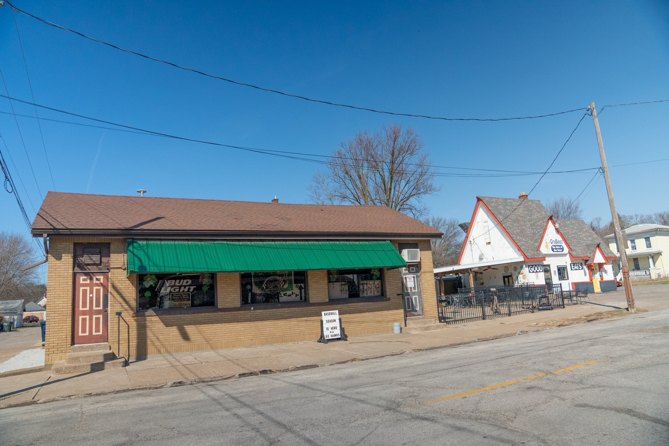




Scan for a Video Tour of the Property!
Owner retiring after 26 successful years - Turnkey commercial + residential investment opportunity
Property Highlights
Four-parcel mixed-use portfolio totaling approximately 7,100+ SF across commercial and residential assets
Two operating commercial properties (±1,804 SF and ±686 SF) with FF&E and goodwill included in sale
Two single-family residential rental homes (±2,135 SF and ±2,496 SF) providing additional income diversification
Combined land area of approximately 0.95 acres across all parcels
Turnkey investment opportunity with established business operations and rental components
Diversified Mixed-Use Portfolio offered strictly as one package – rare opportunity to acquire real estate and operating assets in a single transaction
Mixed-Use
Portfolio
220 N. Pine St., Davenport, IA
FOR SALE | $699,900
TOTAL SQ. FT. | 7,100+ SF
Details
Parcels | J0008-10, J0008-08, J0009-28, J0008-09
Zoning | C-1
Taxes | $9,330.74 (2024)
Lot Size | 0.95 Acres
Year Built | 1936
5111 Utica Ridge Road | Davenport, Iowa 52807
563-355-4000
ruhlcommercial.com
NO WARRANTY OR REPRESENTATION, EXPRESS OR IMPLIED, IS MADE AS TO THE ACCURACY OF THE INFORMATION CONTAINED HEREIN, AND THE SAME IS SUBMITTED SUBJECT TO ERRORS,OMISSIONS, CHANGE OF PRICE, RENTAL OR OTHER CONDITIONS, PRIOR SALE, LEASE OR FINANCING, OR WITHDRAWAL WITHOUT NOTICE, AND OF ANY SPECIAL LISTING CONDITIONS IMPOSED BY OUR PRINCIPALS NO WARRANTIES OR REPRESENTATIONS ARE MADE AS TO THE CONDITION OF THE PROPERTY OR ANY HAZARDS CONTAINED THEREIN ARE ANY TO BE IMPLIED. BROKERS ARE LICENSED IN ILLINOIS AND IOWA. UPDATED: 8/01/22

Slide 2

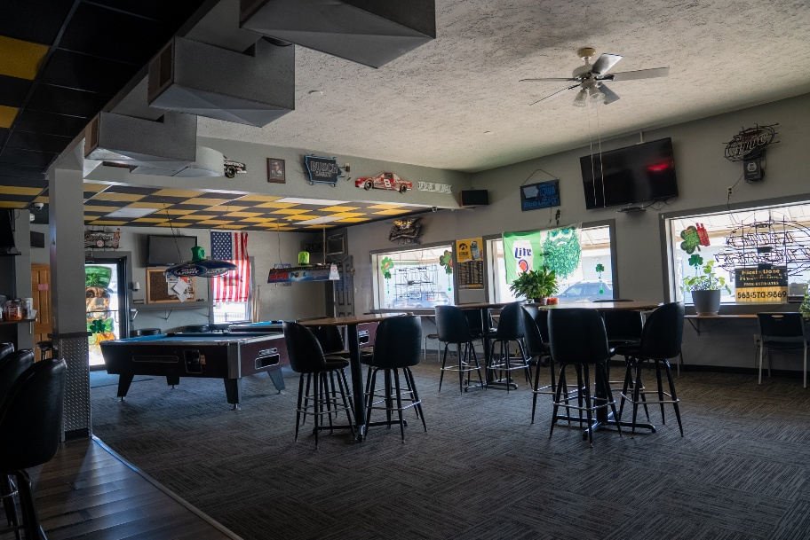
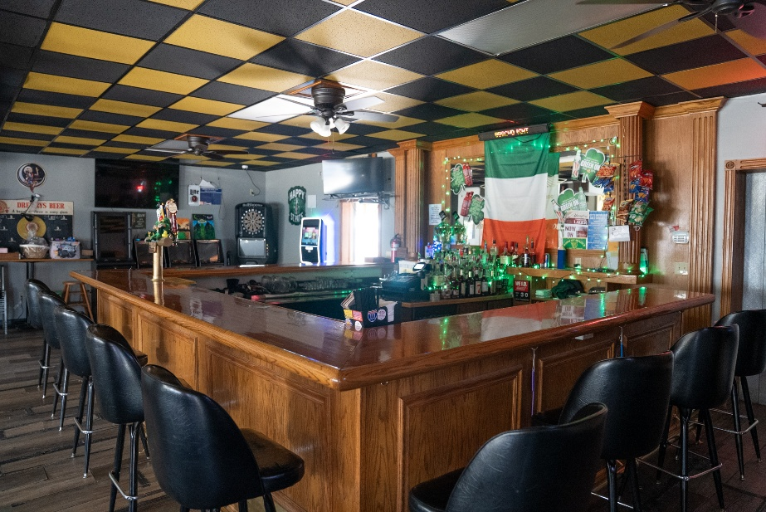
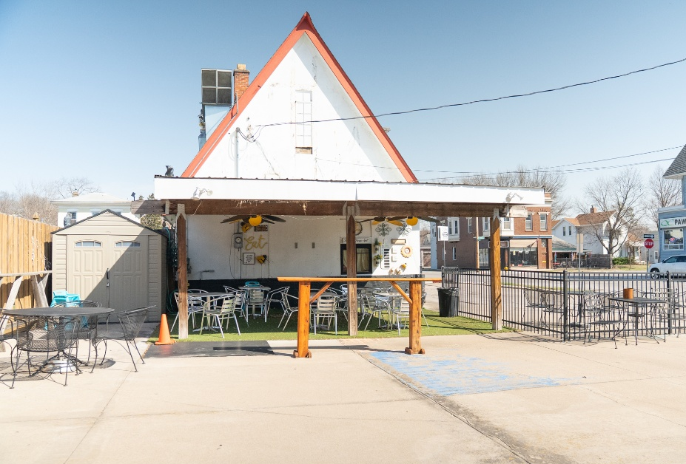
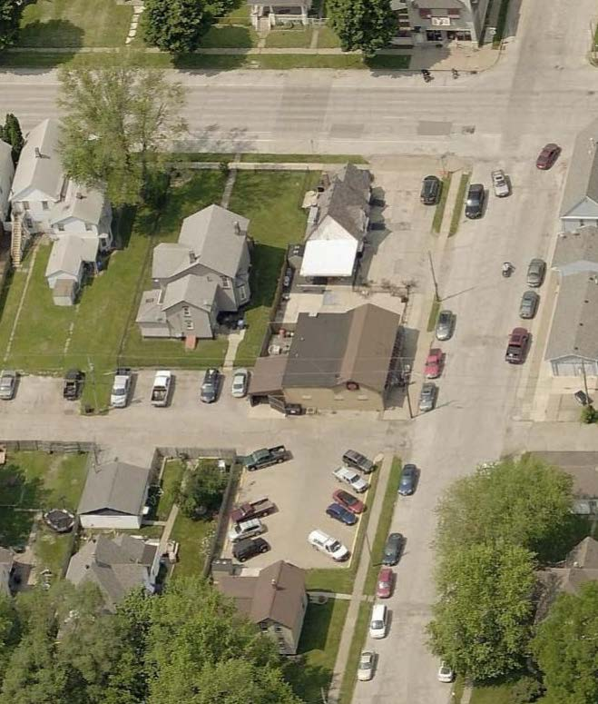
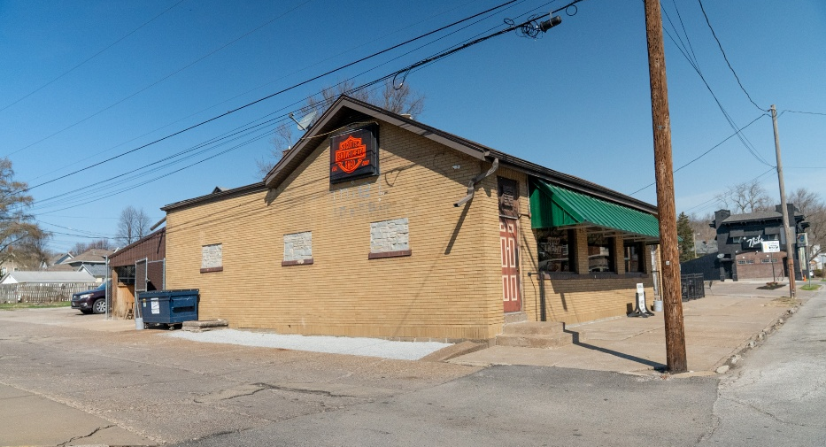
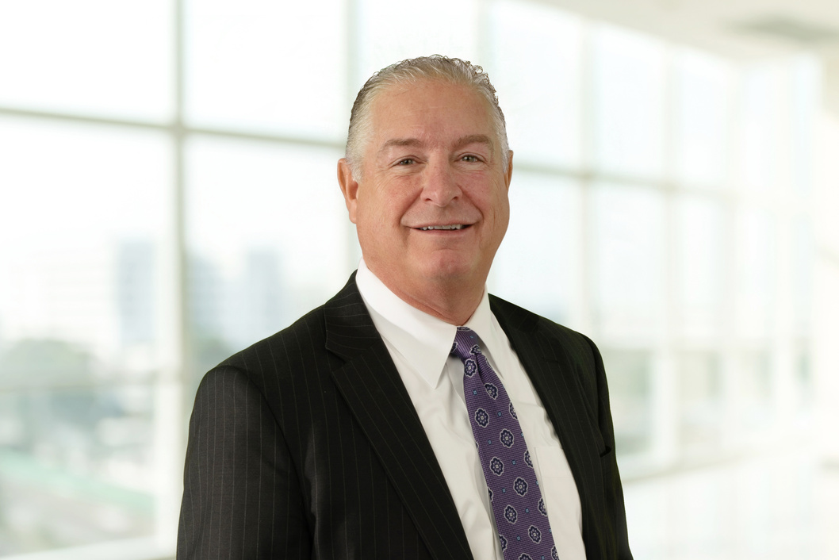
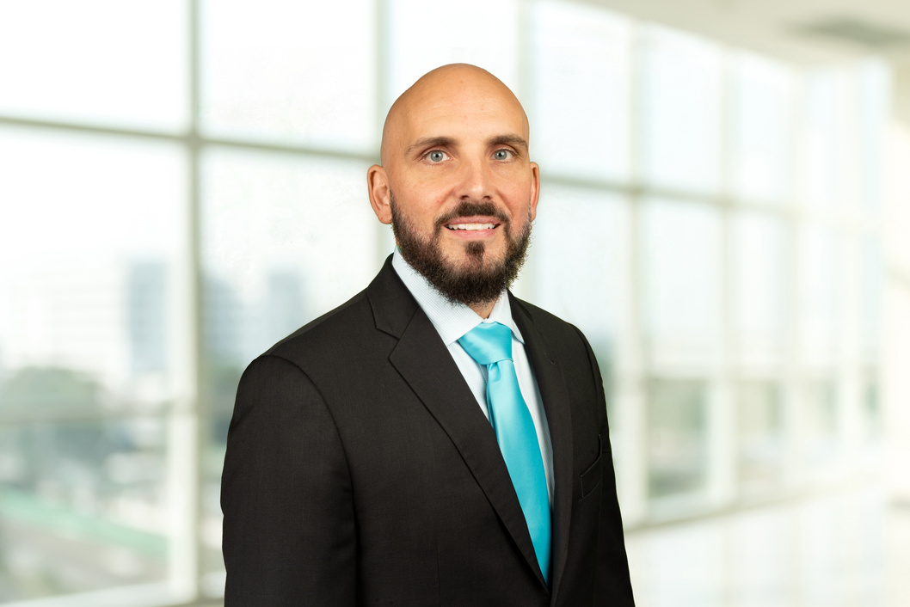

For Sale
7,100+ SF (combined)
Diversified Mixed-Use Portfolio
Commercial 2 Interior
Commercial 2 Interior
W. 3RD ST.
Residence 1
Commercial 1
Commercial 2
Commercial 1
N. PINE ST.
Residence 2
Commercial 2
SHAWN LANGAN
PETE HADJIS
CARRIE LAMB
Vice President/Director
o: 563-823-5113
c: 563-343-6597
e: slangan@ruhlcommercial.com
Sales Manager/Vice President
o: 563-355-4000
c: 319-640-0527
e: phadjis@ruhlcommercial.com
Commercial Sales Associate
o: 563-823-5133
c: 815-716-0264
e: clamb@ruhlcommercial.com
5111 Utica Ridge Road | Davenport, Iowa 52807
563-355-4000
ruhlcommercial.com

Slide 3
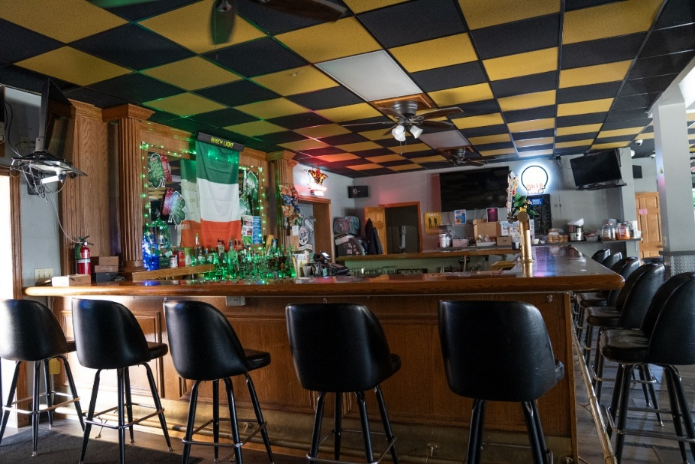
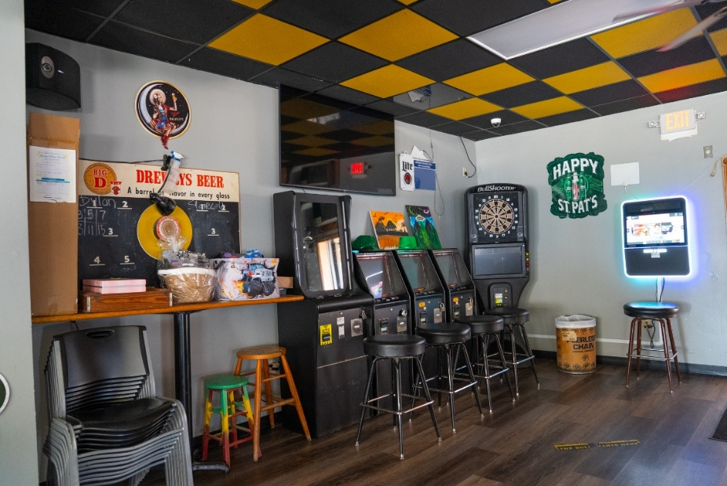
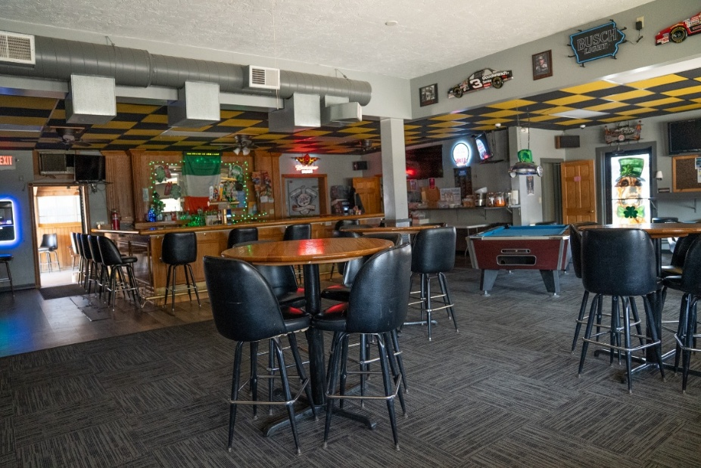
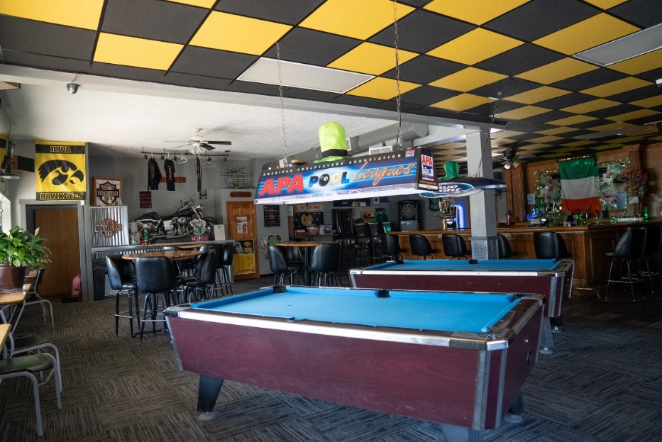
For Sale
7,100+ SF (combined)
Diversified Mixed-Use Portfolio
Commercial 2 Interior
SHAWN LANGAN
PETE HADJIS
CARRIE LAMB
Vice President/Director
o: 563-823-5113
c: 563-343-6597
e: slangan@ruhlcommercial.com
Sales Manager/Vice President
o: 563-355-4000
c: 319-640-0527
e: phadjis@ruhlcommercial.com
Commercial Sales Associate
o: 563-823-5133
c: 815-716-0264
e: clamb@ruhlcommercial.com
5111 Utica Ridge Road | Davenport, Iowa 52807
563-355-4000
ruhlcommercial.com

Slide 4
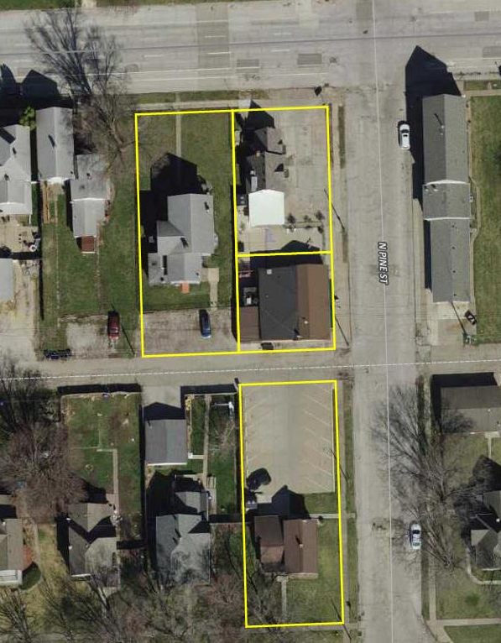
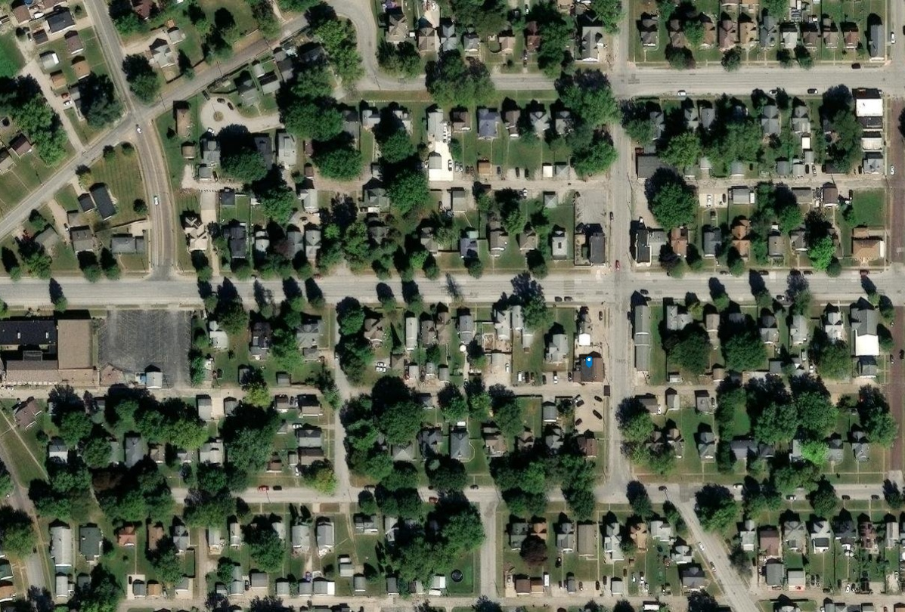
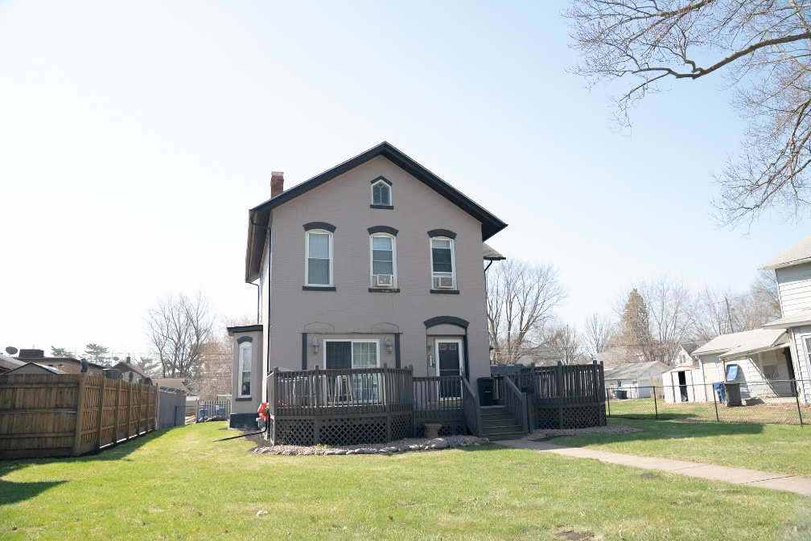
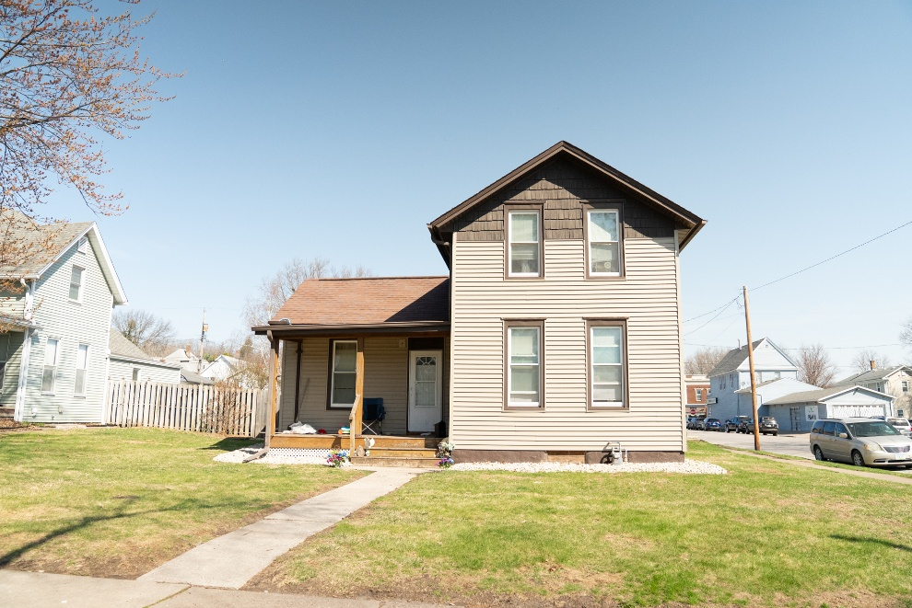
For Sale
7,100+ SF (combined)
Diversified Mixed-Use Portfolio
W. 3RD ST.
J0008-08
TELEGRAPH RD-9,300 VPD
J0008-09
N. PINE ST.
Bar/Grill
J0008-10
W. 3RD ST-5,200 VPD
Church
QC Pawn
Church
J0009-28
5 MILE POPULATION OF 137,807
Residence 1
Residence 2
SHAWN LANGAN
PETE HADJIS
CARRIE LAMB
Vice President/Director
o: 563-823-5113
c: 563-343-6597
e: slangan@ruhlcommercial.com
Sales Manager/Vice President
o: 563-355-4000
c: 319-640-0527
e: phadjis@ruhlcommercial.com
Commercial Sales Associate
o: 563-823-5133
c: 815-716-0264
e: clamb@ruhlcommercial.com
5111 Utica Ridge Road | Davenport, Iowa 52807
563-355-4000
ruhlcommercial.com

Slide 5
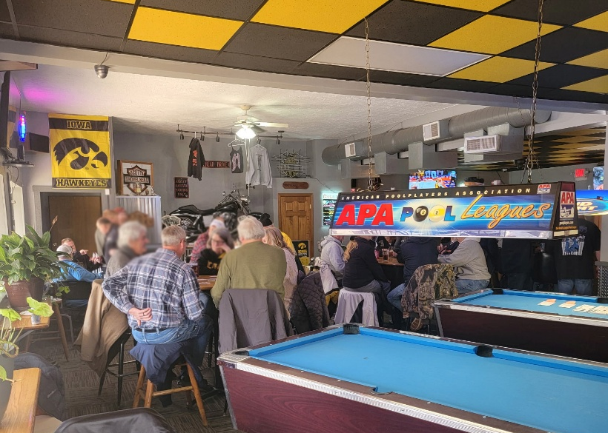
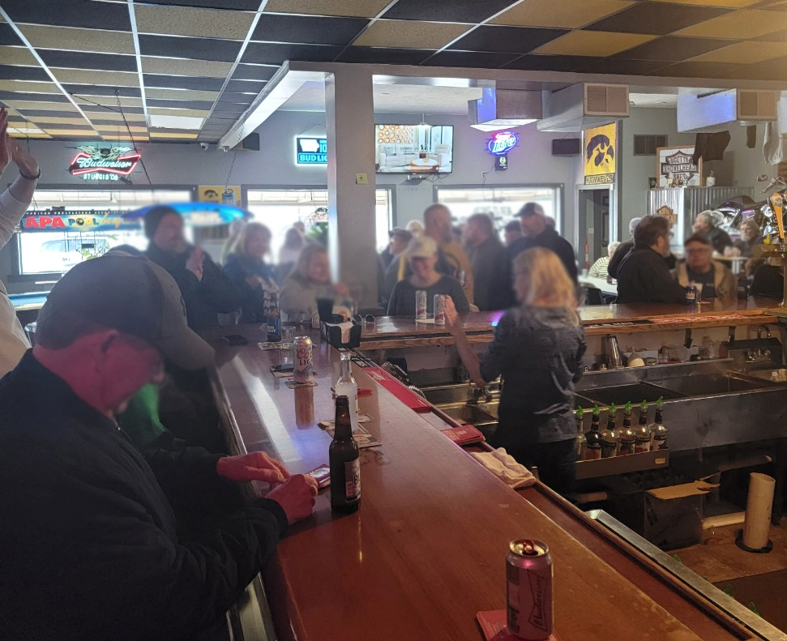
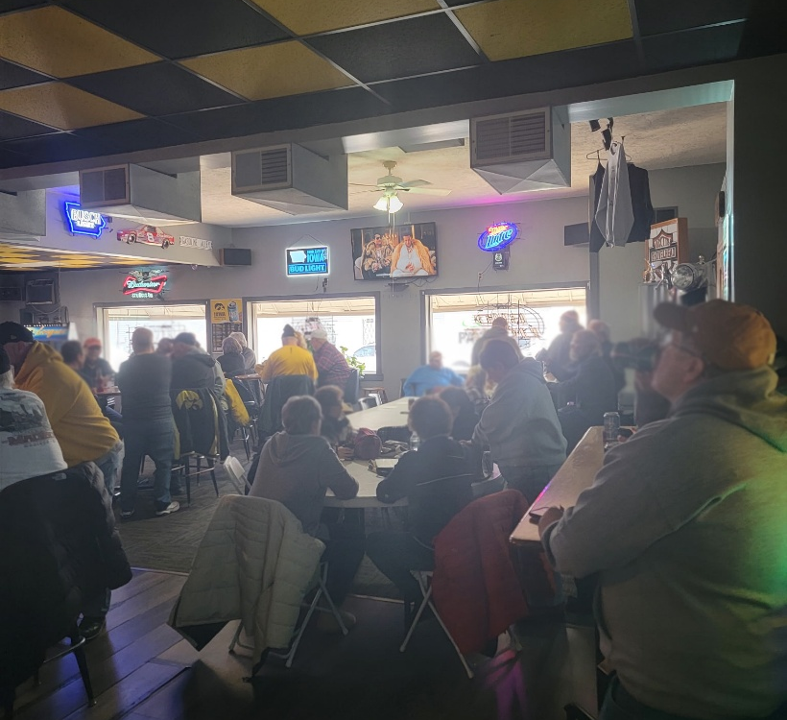
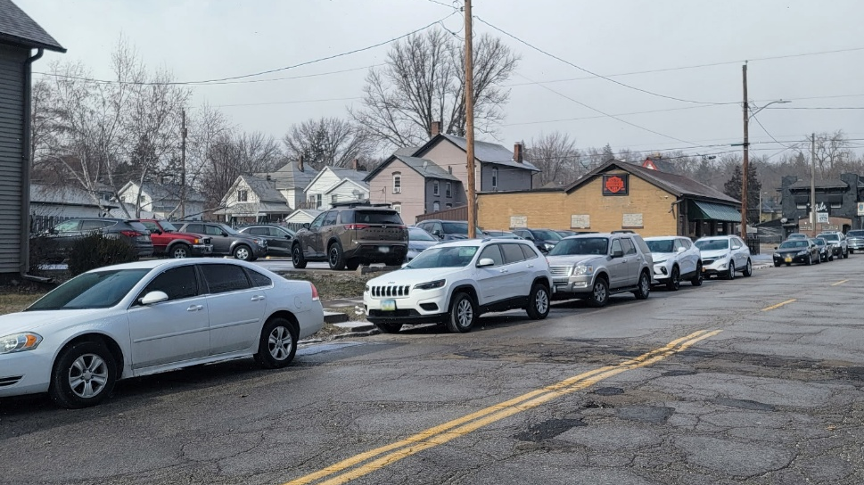
For Sale
7,100+ SF (combined)
Diversified Mixed-Use Portfolio
Photos Reflect A Typical Busy Event
Or Peak Operating Period
SHAWN LANGAN
PETE HADJIS
CARRIE LAMB
Vice President/Director
o: 563-823-5113
c: 563-343-6597
e: slangan@ruhlcommercial.com
Sales Manager/Vice President
o: 563-355-4000
c: 319-640-0527
e: phadjis@ruhlcommercial.com
Commercial Sales Associate
o: 563-823-5133
c: 815-716-0264
e: clamb@ruhlcommercial.com
5111 Utica Ridge Road | Davenport, Iowa 52807
563-355-4000
ruhlcommercial.com

