Slide 1

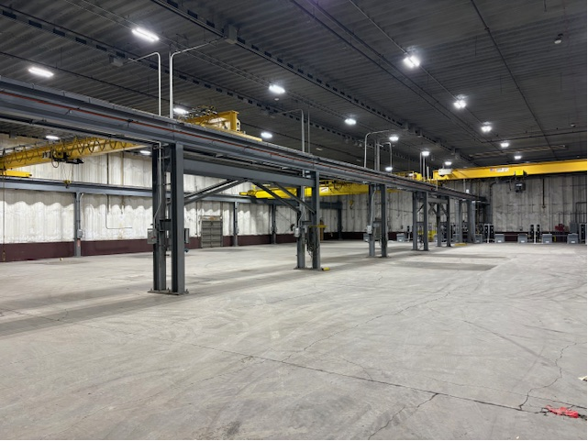




Property Highlights
25,260 SF crane served / heavy power building for sub-lease (Direct lease possible)
24,000 SF shop space (200' x 120') with 24' ceiling
1,260 SF office area includes private office, reception, male and female locker rooms, and restrooms
(2) 5-ton cranes with 17' under beam height and (2) 10-ton cranes with 15'-2" under beam height
2000-amp power, full sprinkler system and compressed air-lines
(1) drive-in ramp door (13' w x 14' h), (1) drive-in ramp door (14' w x 16' h). Dock-high covered platform with (1) leveler and room for 6 trucks. (2) doors at dock platform (10' x 10' each)
“In plant" enclosed area for inspections and air compressor
Fenced area for outside storage
Easy access to I-80 and I-74/ 1 block from Arconic
Manufacturing
Facility (Heavy)
200 S. Bellingham Rd., Bldg. 1
Riverdale, IA 52722
FOR SUB-LEASE | $6.50 PSF NNN
BUILDING SIZE | 25,260 SF
Details
Parcel | 842633001
Zoning | M-1
Year Built | 1968
For more information,
please contact:
RICHARD J. SCHAEFER
Vice President/Director
o: 563-823-5127
c: 563-210-4488
e: rschaefer@ruhlcommercial.com
5111 Utica Ridge Road | Davenport, Iowa 52807
563-355-4000
ruhlcommercial.com
NO WARRANTY OR REPRESENTATION, EXPRESS OR IMPLIED, IS MADE AS TO THE ACCURACY OF THE INFORMATION CONTAINED HEREIN, AND THE SAME IS SUBMITTED SUBJECT TO ERRORS,OMISSIONS, CHANGE OF PRICE, RENTAL OR OTHER CONDITIONS, PRIOR SALE, LEASE OR FINANCING, OR WITHDRAWAL WITHOUT NOTICE, AND OF ANY SPECIAL LISTING CONDITIONS IMPOSED BY OUR PRINCIPALS NO WARRANTIES OR REPRESENTATIONS ARE MADE AS TO THE CONDITION OF THE PROPERTY OR ANY HAZARDS CONTAINED THEREIN ARE ANY TO BE IMPLIED. BROKERS ARE LICENSED IN ILLINOIS AND IOWA. UPDATED: 8/01/22

Slide 2

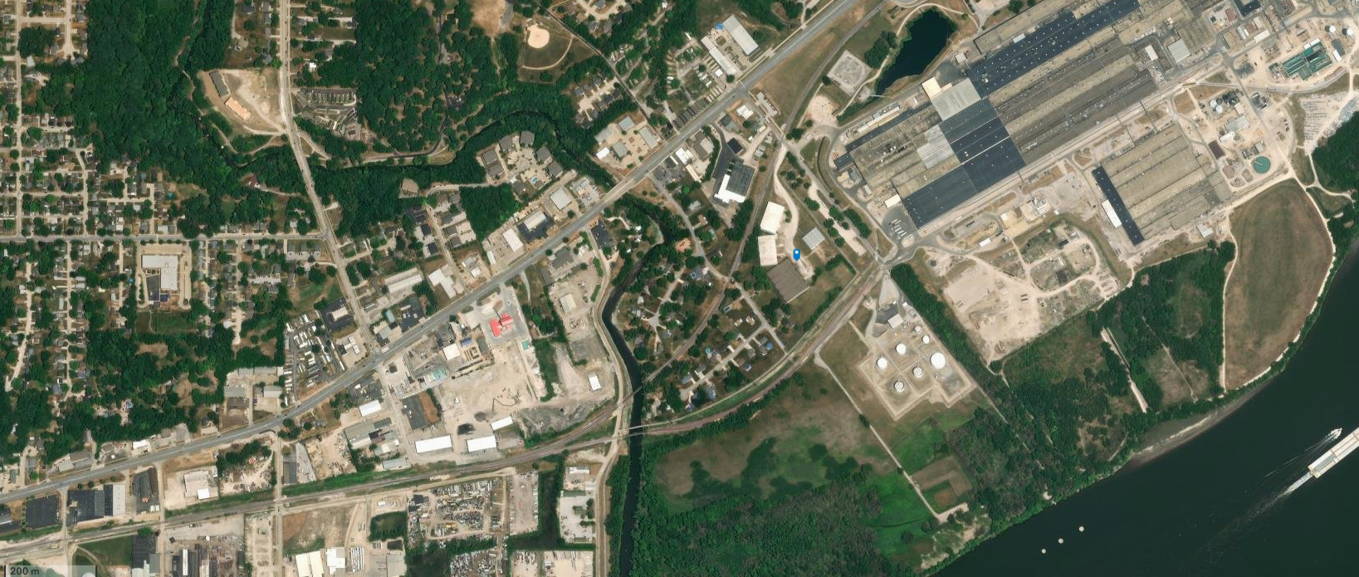

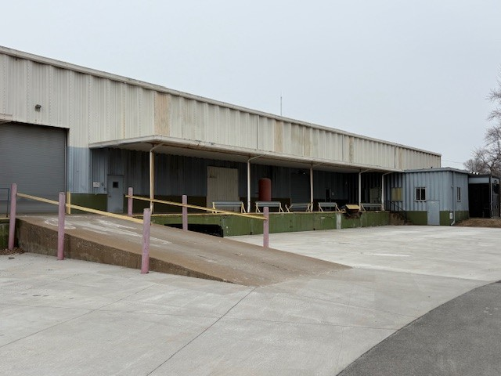
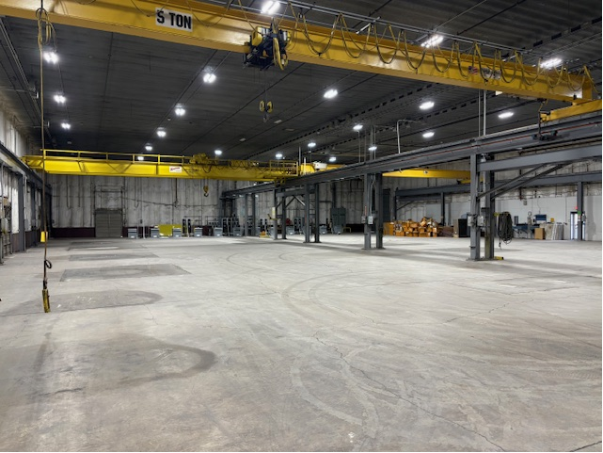

For Sub-Lease
25,260 SF
Heavy Manufacturing Facility
20 MILE POPULATION OF 79,451
STATE ST.-15,500 VPD
^{Mississippi River}
For more information,
please contact:
RICHARD J. SCHAEFER
Vice President/Director
o: 563-823-5127
c: 563-210-4488
e: rschaefer@ruhlcommercial.com
5111 Utica Ridge Road | Davenport, Iowa 52807
563-355-4000
ruhlcommercial.com

Slide 3
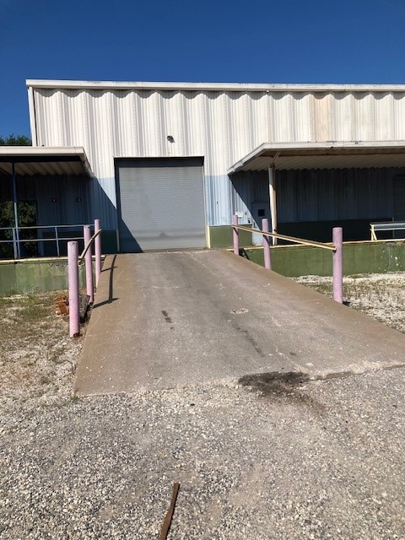
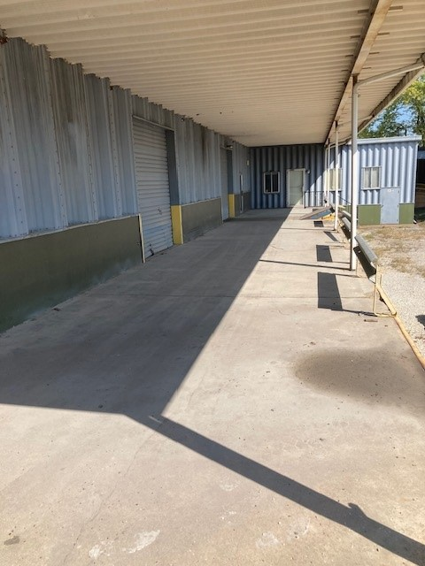
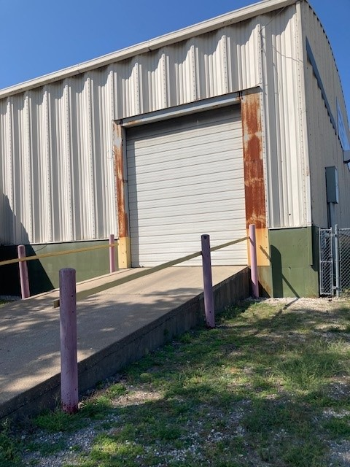
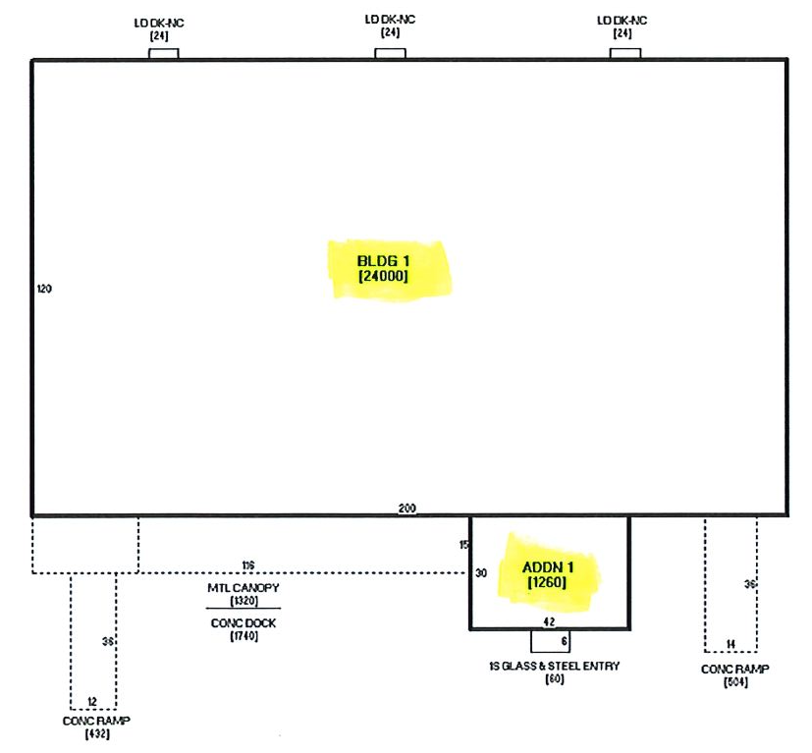
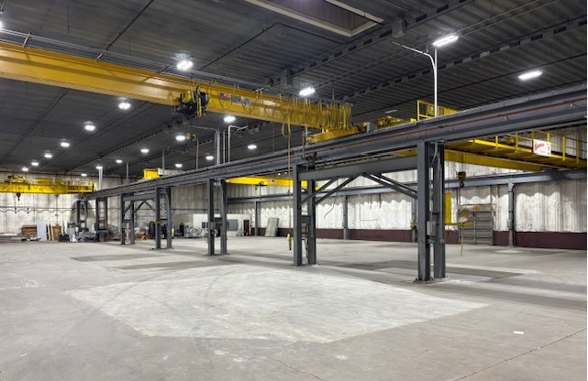
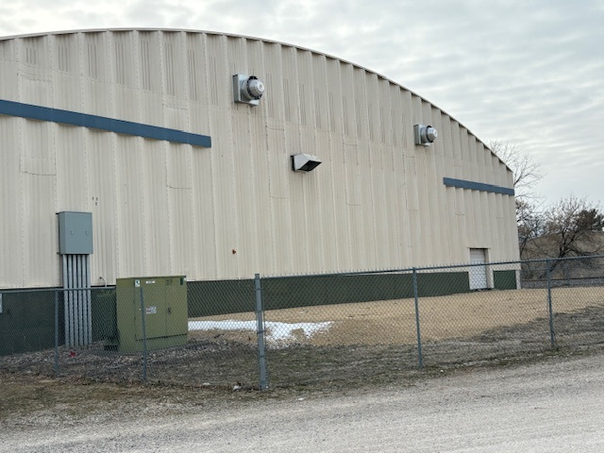
For Sub-Lease
25,260 SF
Heavy Manufacturing Facility
For more information,
please contact:
RICHARD J. SCHAEFER
Vice President/Director
o: 563-823-5127
c: 563-210-4488
e: rschaefer@ruhlcommercial.com
5111 Utica Ridge Road | Davenport, Iowa 52807
563-355-4000
ruhlcommercial.com

